Slide 1

Predicting Returns with Text Data
Textual
Analysis
Sijie Hou, Qingyu Zhang, Yuexi Zheng, Hanchi Zhang, Minhan Sun, Yao Huang

Slide 2
Methodology
ONE
/01

Slide 3
Part 01
Model Setup
Part 02
Screening for Sentiment Words
Methodology
Part 03
Learning Sentiment Distributions
Part 04
Scoring New Articles

Slide 4

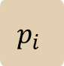


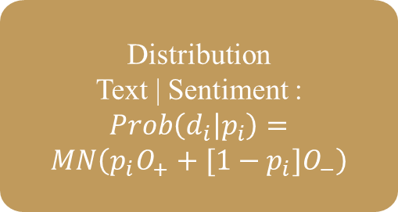


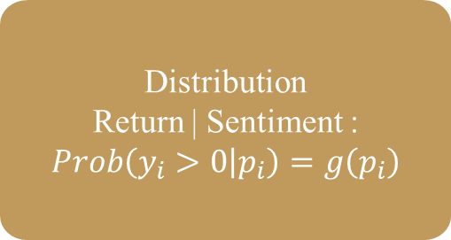
Model Structure
Realized article $d_{i}$
$$p_{i}$$
Realized return $y_{i}$
Purely Negative
Article Word
Distribution: $O_{−}$
Distribution
Text | Sentiment :
$$Prob\left(d_{i} | p_{i}\right)=$$
$$MN\left(p_{i}O_{+}+[1−p_{i}{]O}_{−}\right)$$
Distribution
Return | Sentiment :
$$Prob\left(y_{i}>0 | p_{i}\right)=g\left(p_{i}\right)$$
Purely Positive
Article Word
Distribution: $O_{+}$
Underlying Sentiment $p_{i}$

Slide 5
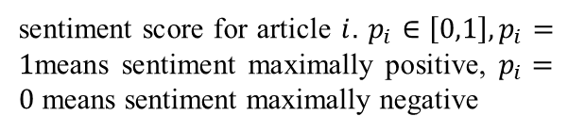
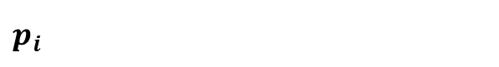
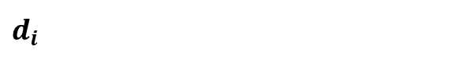
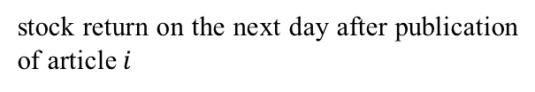
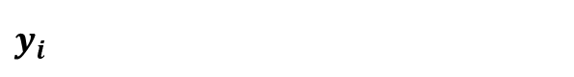
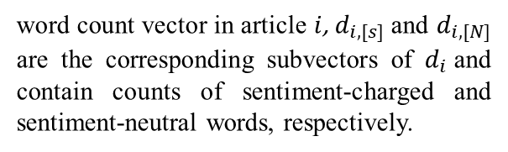
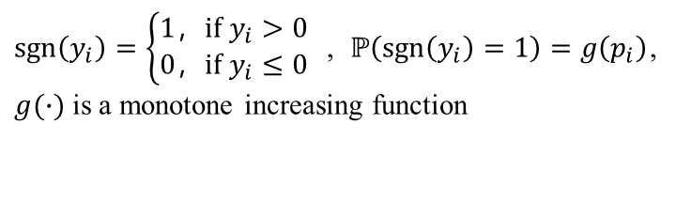
Model Setup
$$d_{i}$$
word count vector in article $i$, $d_{i,[s]}$and $d_{i,[N]}$ are the corresponding subvectors of $d_{i}$and contain counts of sentiment-charged and sentiment-neutral words, respectively.
$O_{+}$ $O_{−}$
describes expected counts for words in a maximally positive/ negative sentiment article
$$y_{i}$$
stock return on the next day after publication of article $i$
Sign function:
$$p_{i}$$
$\operatorname{sgn}\left(y_{i}\right)=\left\{\begin{aligned}1，if y_{i}>0 \\ 0，if y_{i}≤0\end{aligned}\right.$ , $ℙ\left(\operatorname{sgn}\left(y_{i}\right)=1\right)=g\left(p_{i}\right)$, $g(∙)$ is a monotone increasing function
sentiment score for article $i$. $p_{i}∈\left[0,1\right], p_{i}=1$means sentiment maximally positive, $p_{i}=0$ means sentiment maximally negative

Slide 6
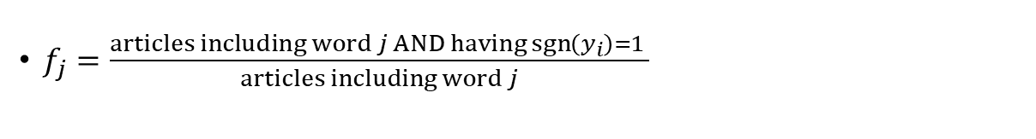
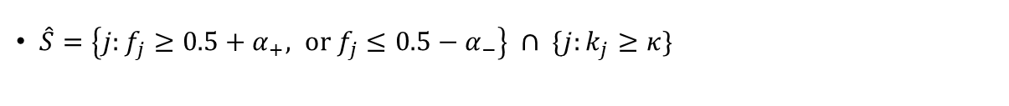
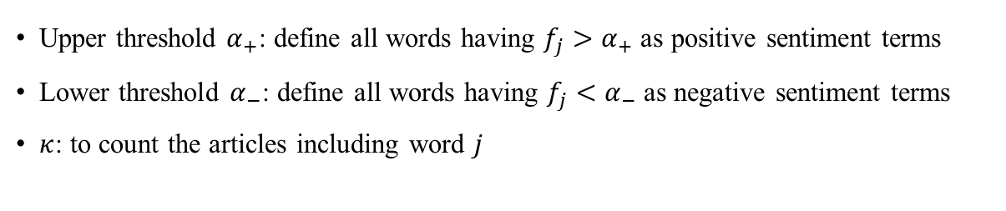
Screening for Sentiment Words
Calculate the frequency of word $j_{i}$
$f_{j}=\frac{articles including word j AND having\operatorname{sgn}\left(y_{i}\right)=1 }{articles including word j}$
Isolate the subset
of sentiment-charged
words
Set hyper-parameters
Upper threshold $α_{+}$: define all words having $f_{j}>α_{+}$ as positive sentiment terms
Lower threshold $α_{−}$: define all words having $f_{j}<α_{−}$ as negative sentiment terms
$κ$: to count the articles including word $j$
Estimate a topic
model to this
subset alone
Construct wordlist $S$
$\hat{S}=\left\{j:f_{j}≥0.5+α_{+}, or f_{j}≤0.5−α_{−}\right\} ∩ \{j:k_{j}≥κ\}$

Slide 7
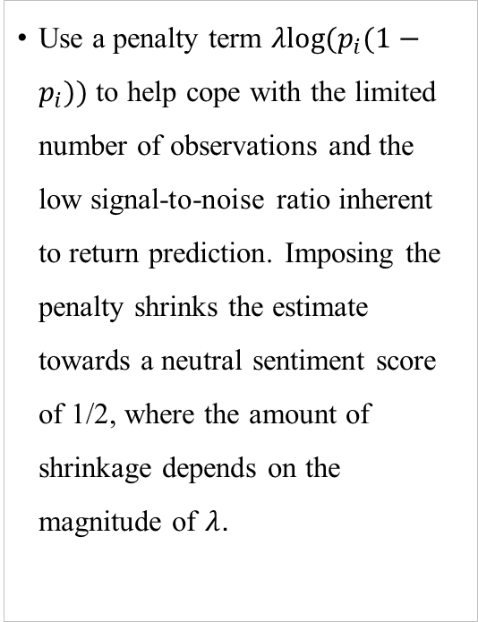
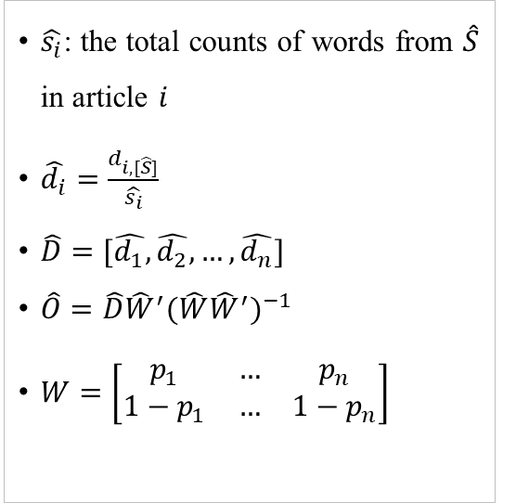
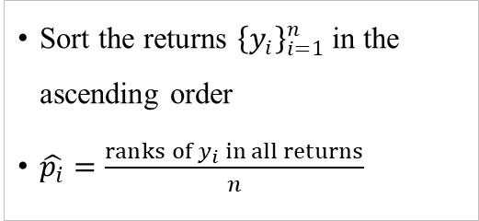
Learning and Scoring
Scouring New Articles
Use a penalty term $λlog⁡(p_{i}(1−p_{i}))$ to help cope with the limited number of observations and the low signal-to-noise ratio inherent to return prediction. Imposing the penalty shrinks the estimate towards a neutral sentiment score of 1/2, where the amount of shrinkage depends on the magnitude of $λ$.
Sentimental Distribution
$\hat{s_{i}}$: the total counts of words from $\hat{S}$ in article $i$
$\hat{d_{i}}=\frac{d_{i,[\hat{S}]}}{\hat{s_{i}}}$
$\hat{D}=[\hat{d_{1}},\hat{d_{2}}, …,\hat{d_{n}}]$
$\hat{O}=\hat{D}{\hat{W}}^{′}{(\hat{W}{\hat{W}}^{′})}^{−1}$
$W=\left[\begin{matrix}p_{1} & … & p_{n} \\ 1−p_{1} & … & 1−p_{n}\end{matrix}\right]$
Use ranks as Scores
Sort the returns ${\left\{y_{i}\right\}}_{i=1}^{n}$in the ascending order
$\hat{p_{i}}=\frac{ranks of y_{i} in all returns}{n}$

Slide 8
Pre-processing and Training
ONE
/02

Slide 9
Data and Filtering
2018.12
-
2020.1
16 stocks
22684
17682
Articles released between 2018.12-2020.1 from Bloomberg
Choose stocks with large amount of articles
Remove articles with more than one stocks tagged
Remove articles without returns on next day

Slide 10
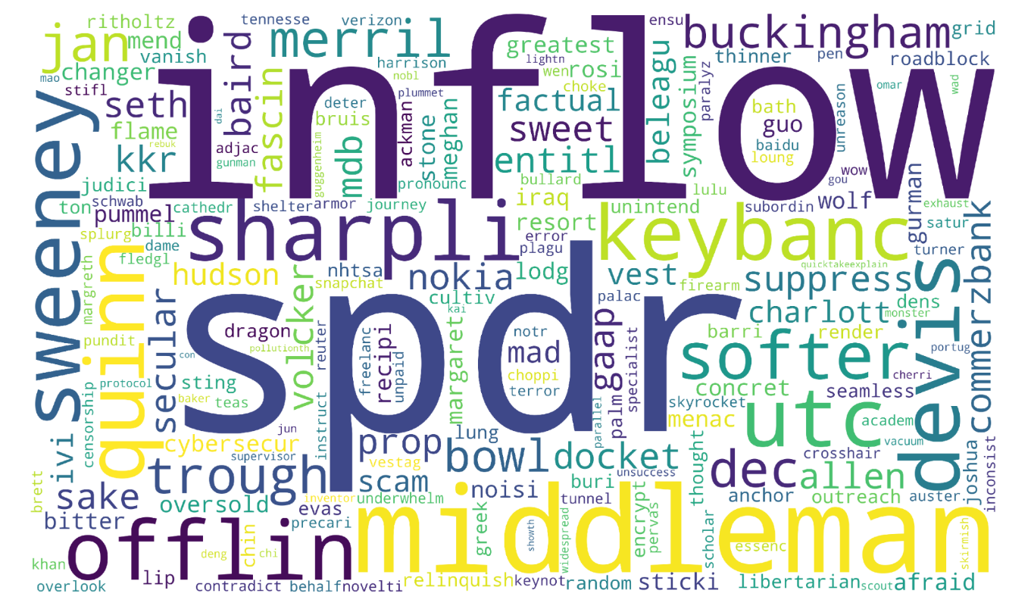
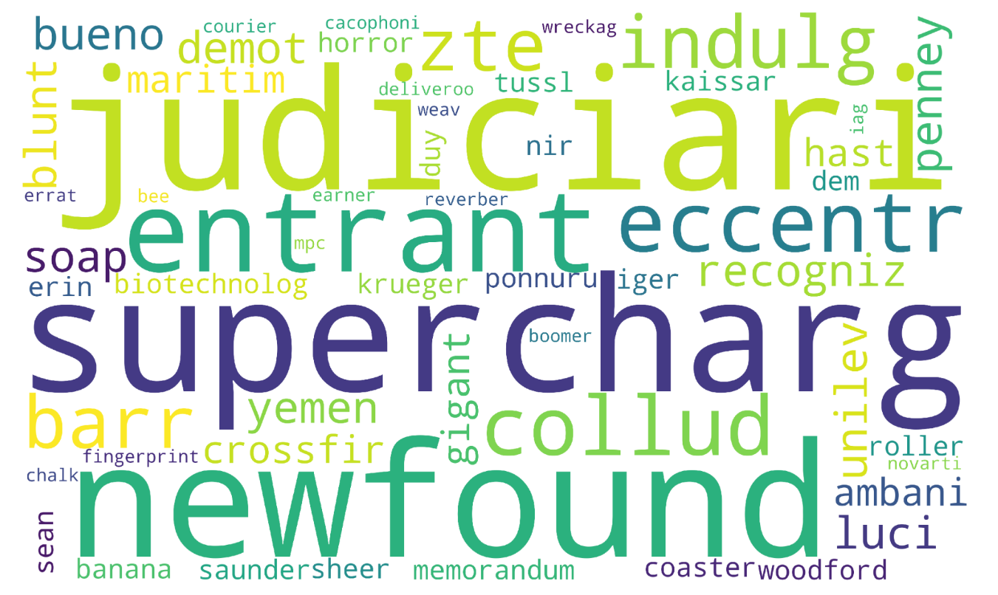

Sentiment-charged Words
Negative words
Positive words

Slide 11
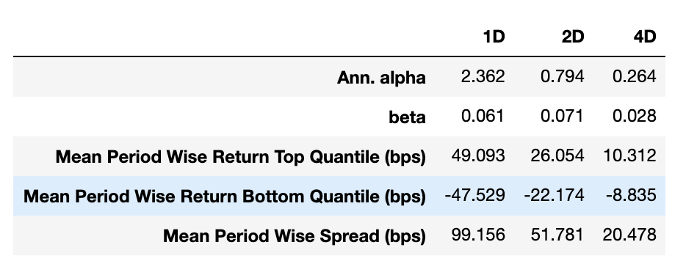
Model Assessment: Train Return

Slide 12
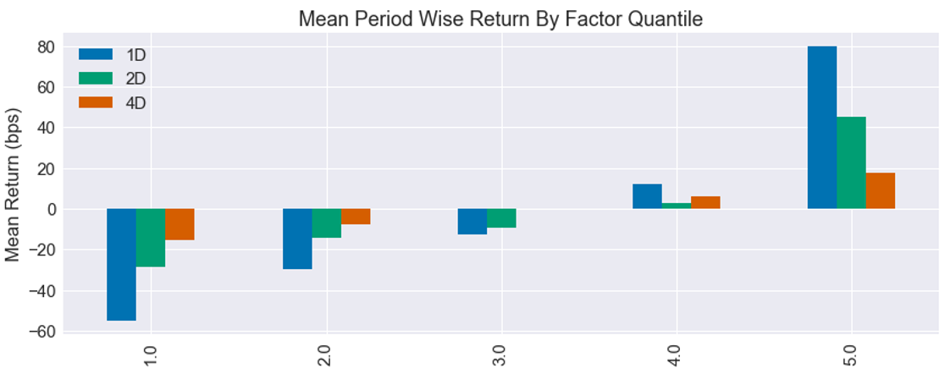
Model Assessment: Train Return

Slide 13
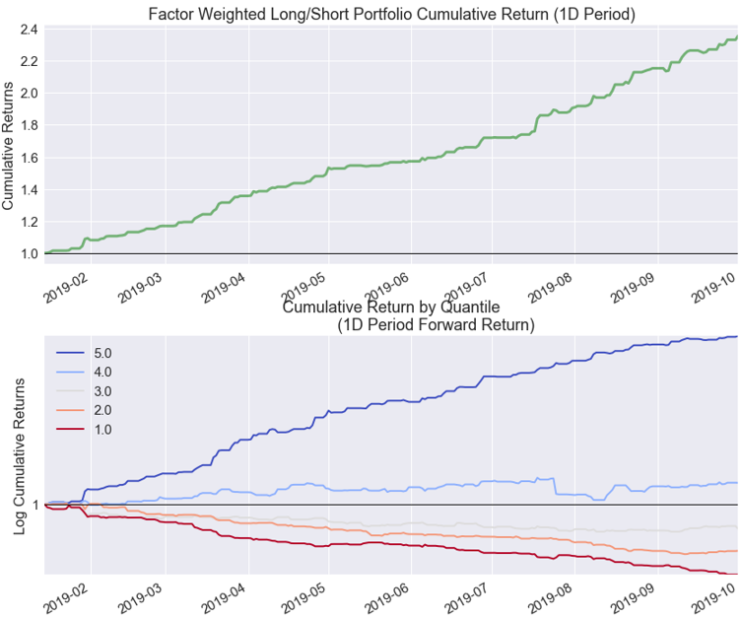
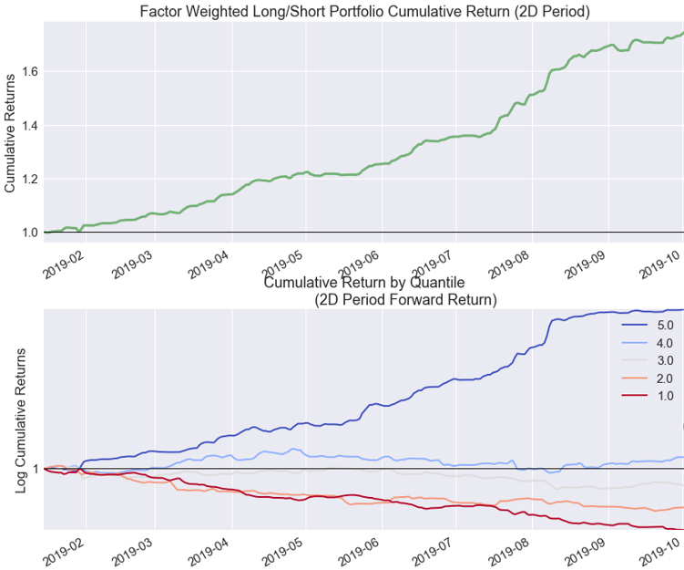
Model Assessment : Train Return

Slide 14
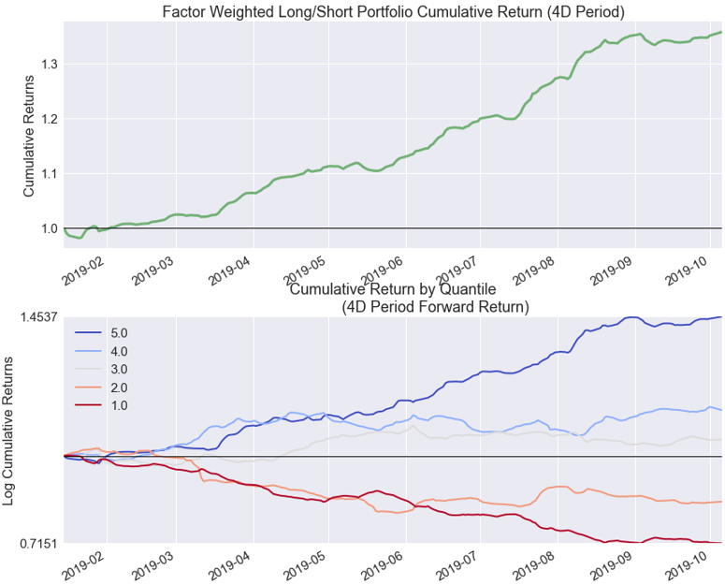
Model Assessment : Train Return

Slide 15
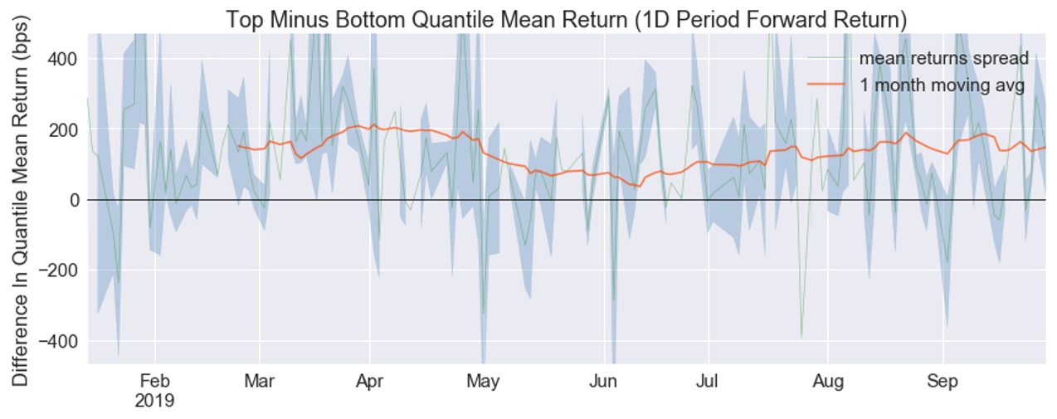
Model Assessment : Train Return

Slide 16
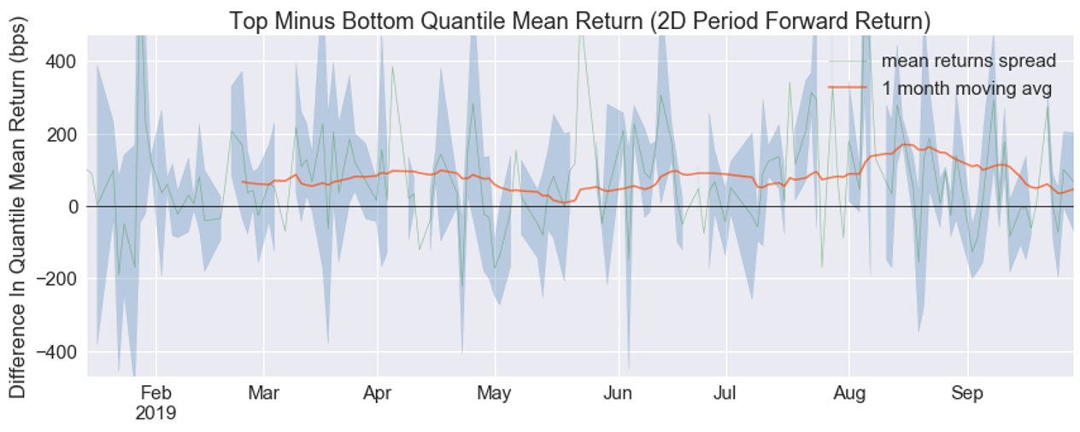
Model Assessment : Train Return

Slide 17
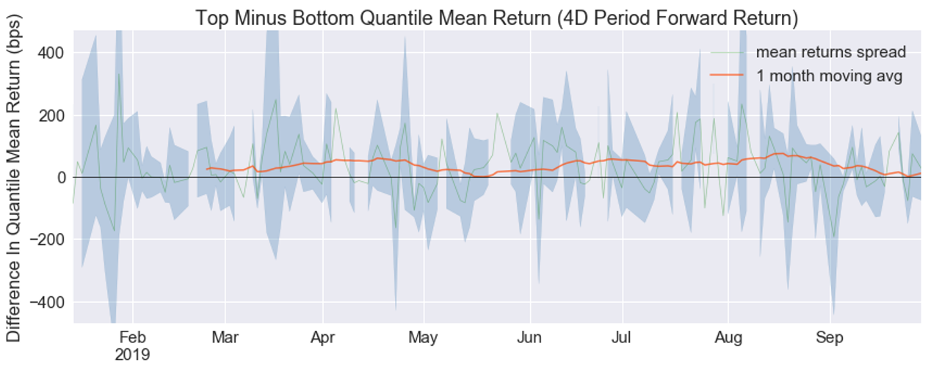
Model Assessment : Train Return

Slide 18
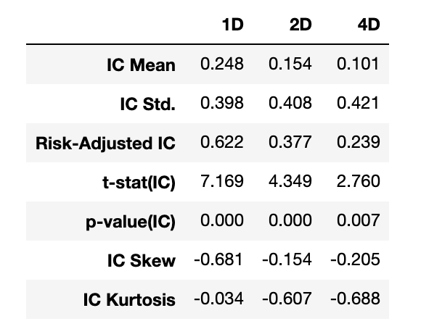
Model Assessment: Train IC

Slide 19
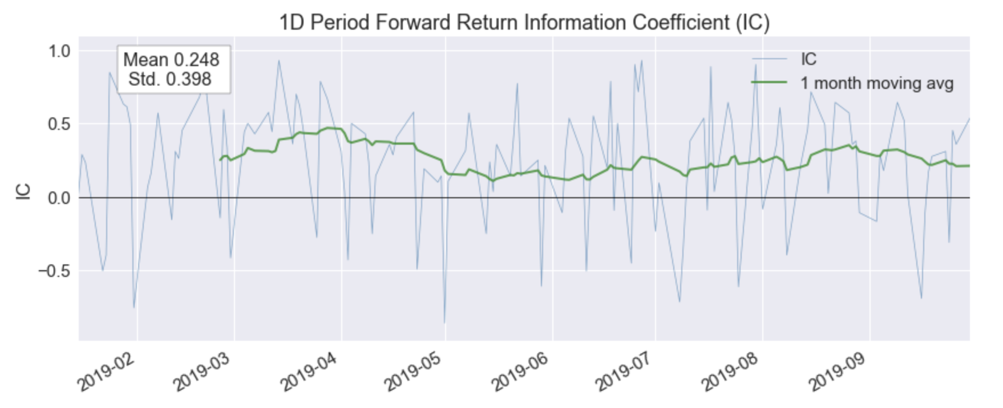
Model Assessment: Train IC

Slide 20
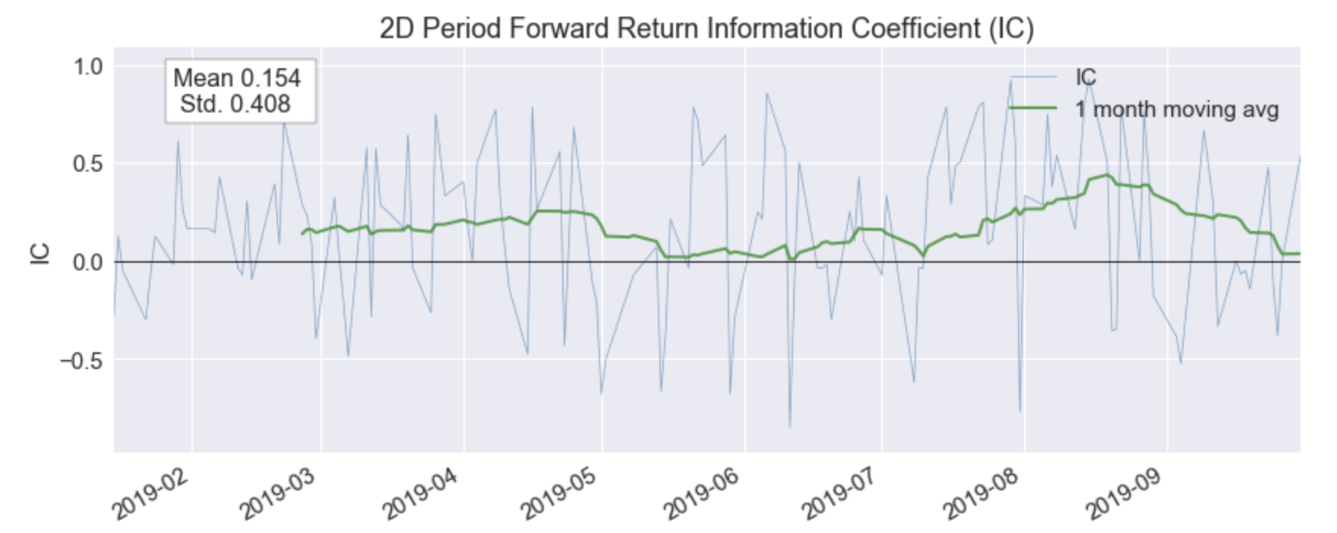
Model Assessment: Train IC

Slide 21
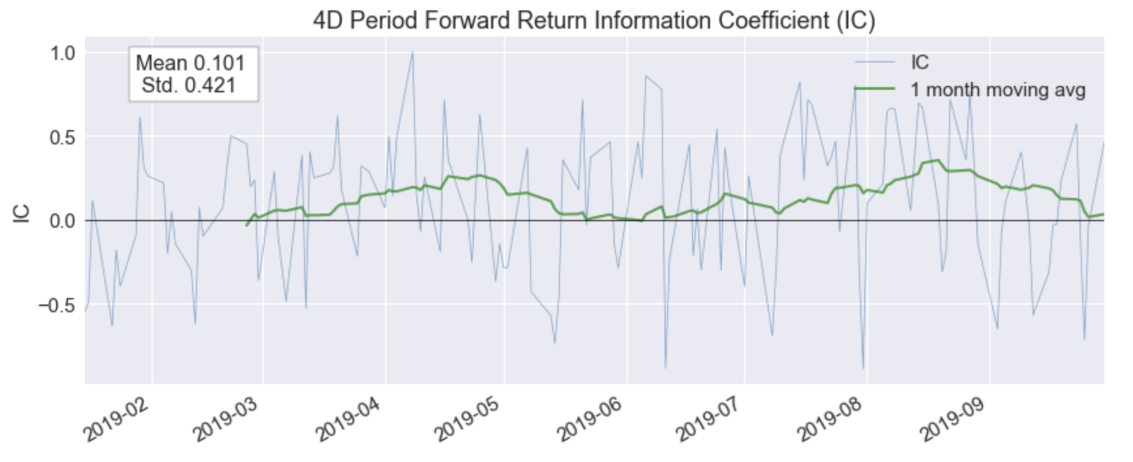
Model Assessment: Train IC

Slide 22
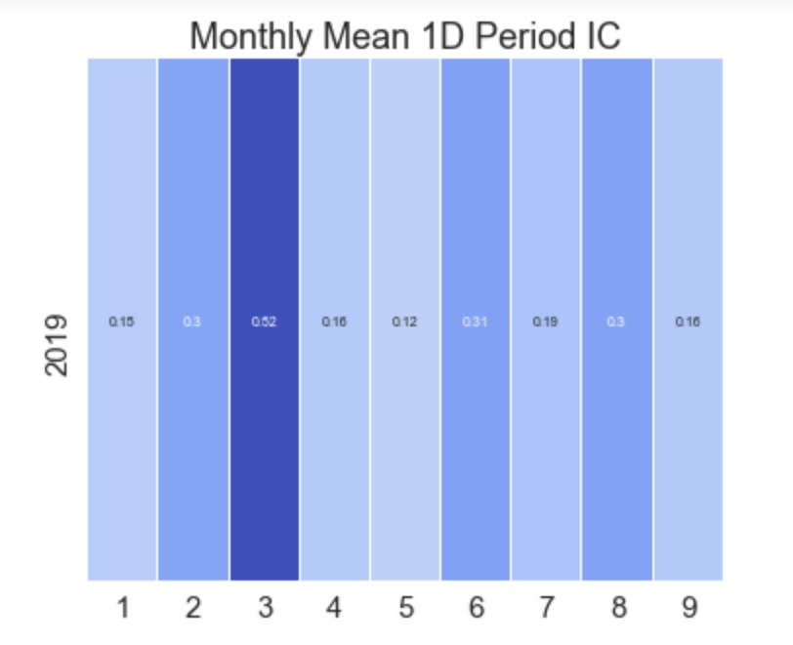
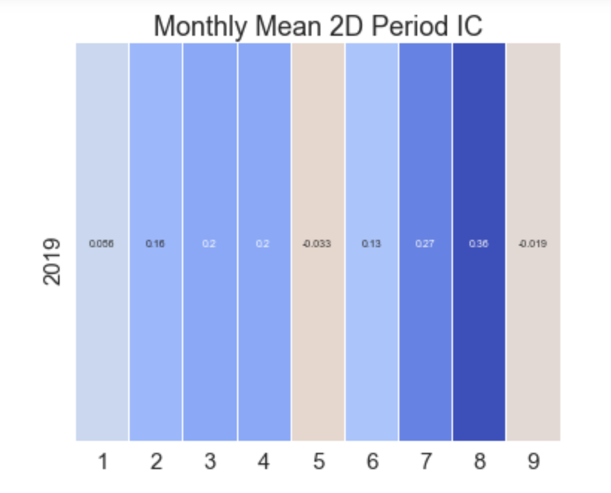
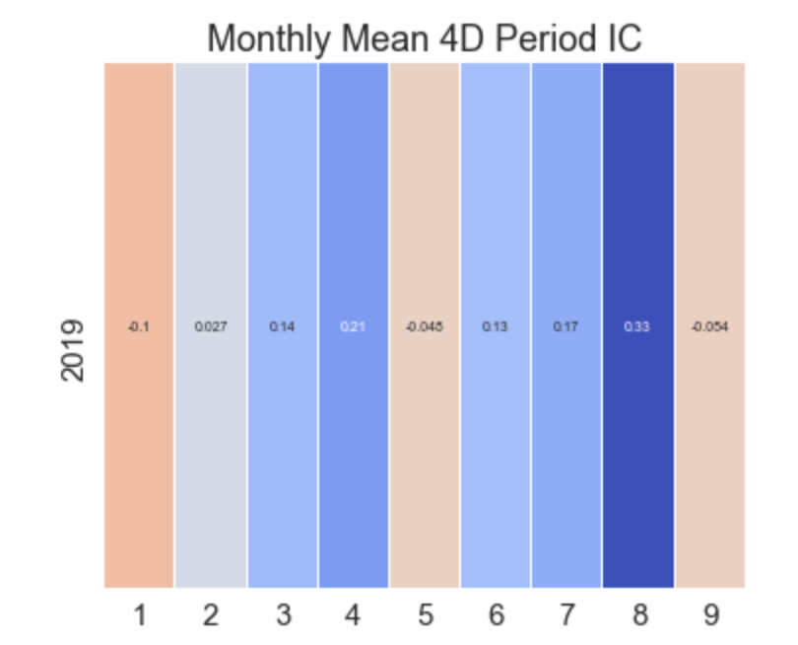
Model Assessment: Train IC

Slide 23
Test and Result
ONE
/03

Slide 24
Trade using Sentimental Score
Score
Rank
Buy
Sell
Use training model to score new articles
Get first 5 stocks with highest score
On the next day after publication, buy those 5 stocks with setting weights at open price
Sell all stocks on the next day after buying at open price

Slide 25
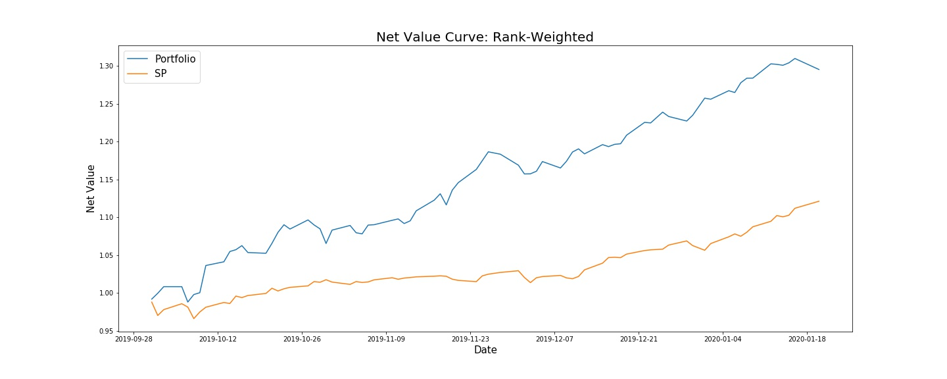
Back Test Result

Slide 26
Back Test Result: Famma-French 3 Factors Model Regression
Coefficients: | Estimate | Std. Error | t value | Pr(>|t|)
(Intercept) | -0.0033570 | 0.0015023 | -2.235 | 0.0306 *
mkt | -0.0001048 | 0.0024917 | -0.042 | 0.9666
HML | 0.0015634 | 0.0026994 | 0.579 | 0.5654
SMB | 0.0028692 | 0.0038593 | -0.743 | 0.4612

Slide 27
Analysis
ONE
/04

Slide 28
Further Improvements of Research
Methodology
Treat bearish period and bullish period separately
Use excess-market return as positive criteria
Data source
Lack of enough eligible large samples
Resulted in inexplicable words in lists
Does larger sample lead to more reasonable result?
Trading Strategy
Treat publications in different ways which’re released during trading time or closed time
Use negative words lists as criteria to offset or sell short

Slide 29
THANKS
Sijie Hou, Qinyu Zhang, Yuexi Zheng, Hanchi Zhang, Minhan Sun, Yao Huang

